Slide 1
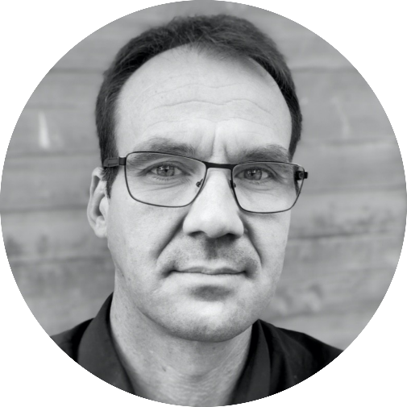
Opening
Adrien Badel – Head of Polytech Annecy Chambéry

Slide 2
JFWM2022 Program
Adrien Badel – Head of Polytech Annecy Chambéry

Slide 3


Facts

Slide 4
Program
Lectures
Keynotes
Tutorials
Practical work

Slide 5
Challenge
Fabien Formosa – Professor, Polytech Annecy Chambéry
Hugues Favrelière – Assistant Professor, Polytech Annecy Chambéry
Luc Marechal – Assistant Professor, Polytech Annecy Chambéry

Slide 6
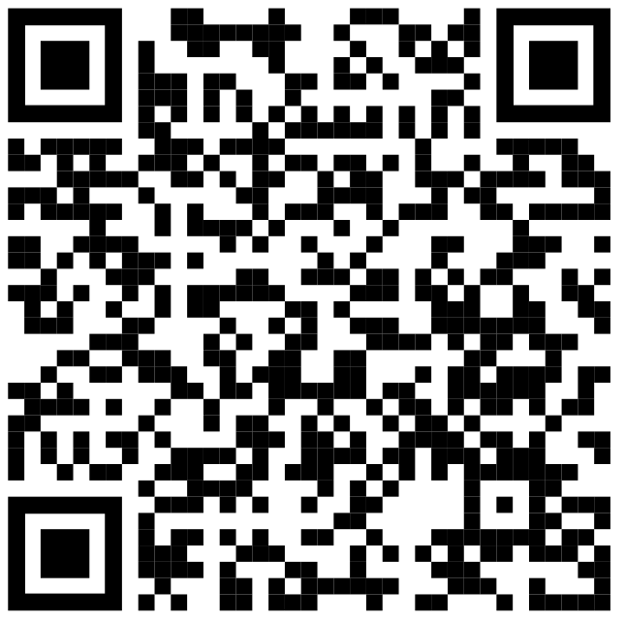

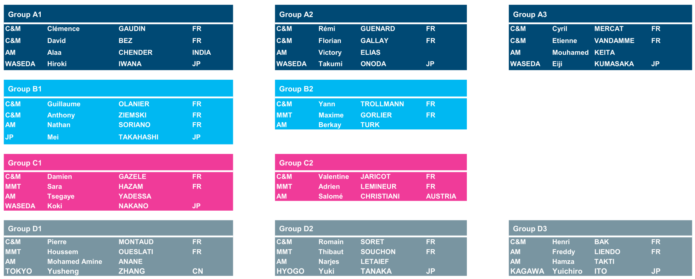
Groups
6 TEAMS of 7 students
ALLOCATED group letters and students names

Slide 7
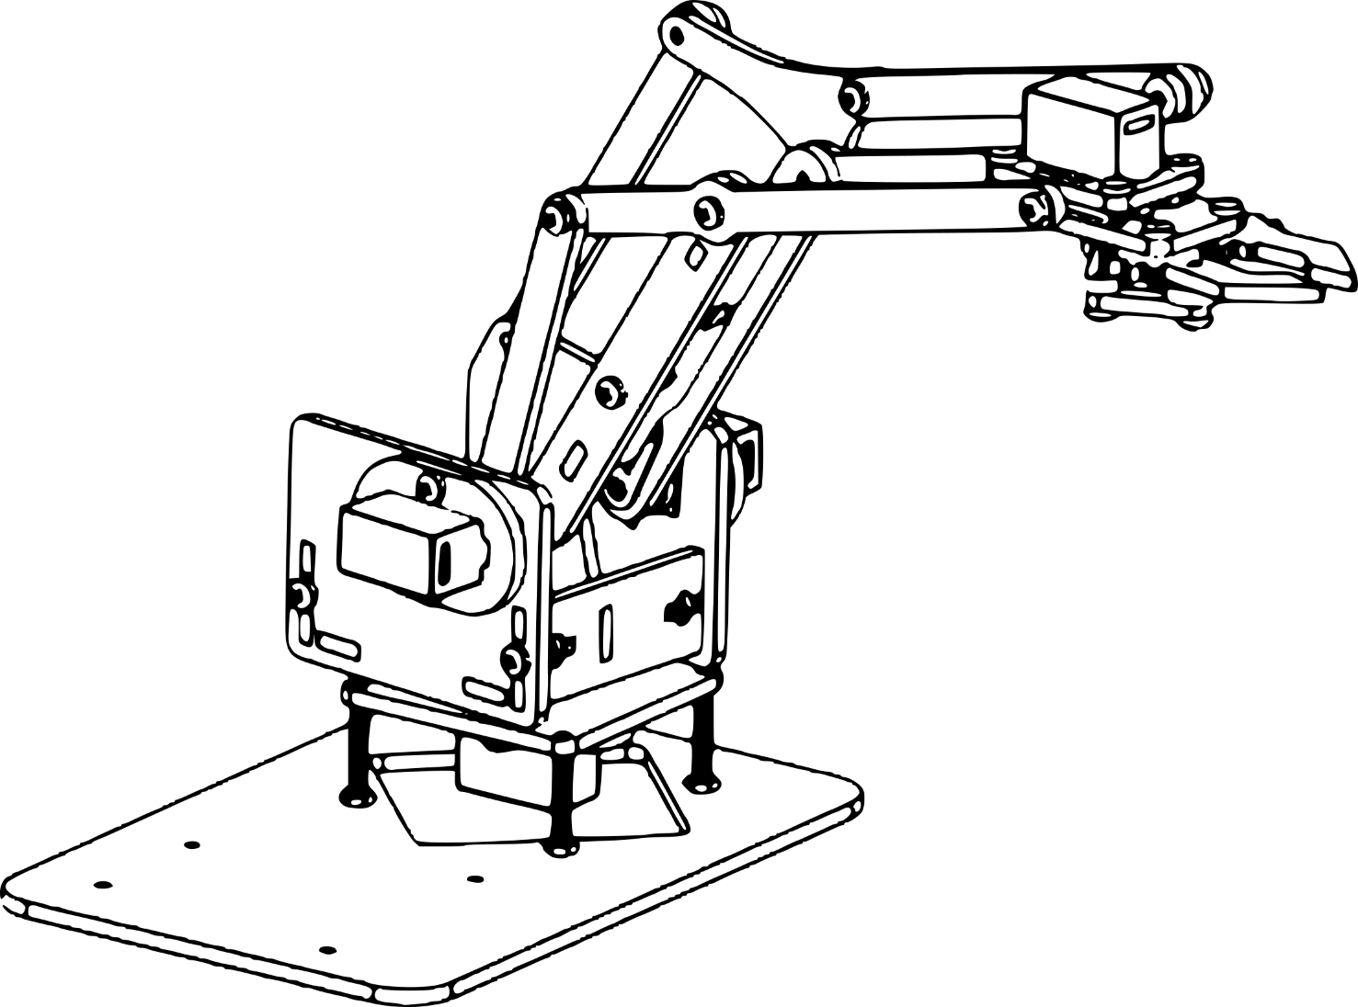
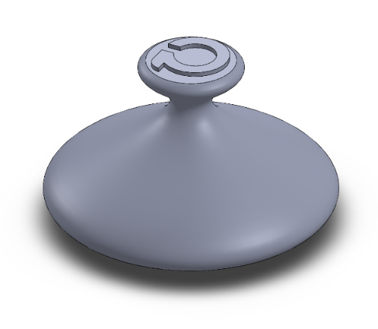
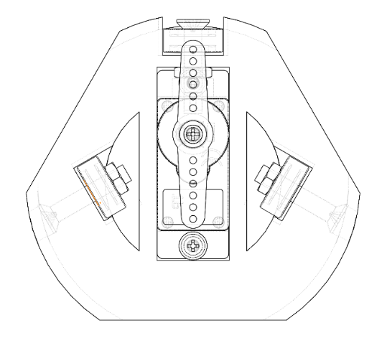
Context
MULTI DOF miniature robotic arm
➔ Arduino control
➔ 4 DOF
MECHANICAL DESIGN
FABRICATION
➔ 3D Printing
ASSEMBLY
DEMONSTRATION

Slide 8


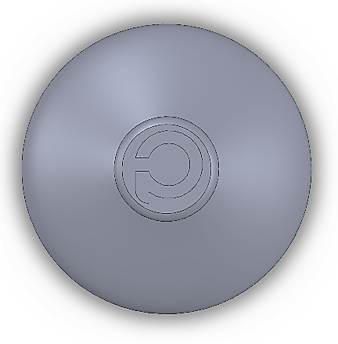
Challenge brief
DEMONSTRATE: a functional 4DOF robotic arm using
➔ ACHIEVING a specific “grab-move-drop” motion
➔ MAXIMIZING the precision and smoothness of the motion
I
II
III

Slide 9
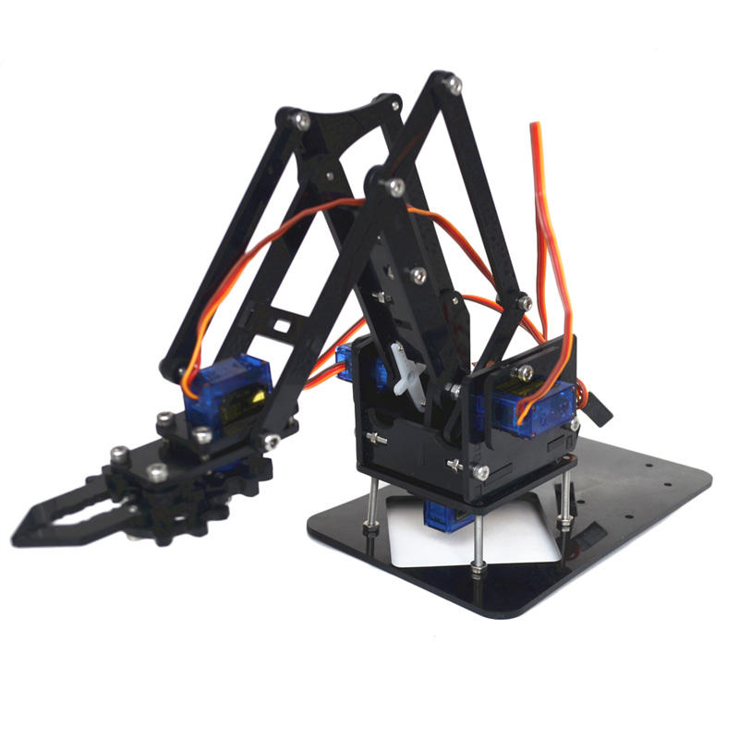
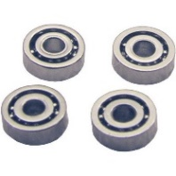

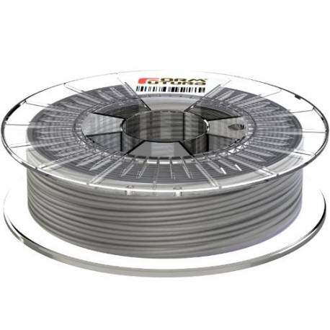
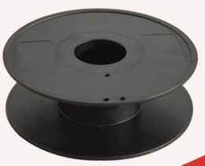
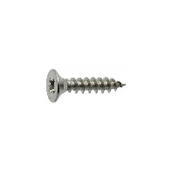
Challenge brief
DESIGN: a constrained 3D printed interface
➔ MINIMIZING the material
➔ MINIMIZING the number of mechanical parts
➔ MAXIMIZING the stiffness and smoothness

Slide 10
Timeline
Friday September, 13
90’ min (all groups)
Tuesday September, 17
90’ min (group B,C,D)
Wednesday September, 18
90’ min (group A)
Final demonstration: Friday September, 20
Professors will discuss and define which is the best accomplishment
(achievement of goals, demonstration, teamwork)

Slide 11
Day trip Saturday 10

Slide 12
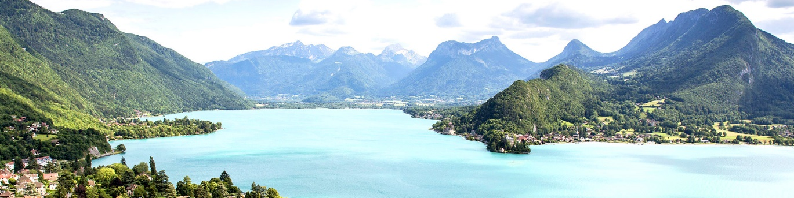
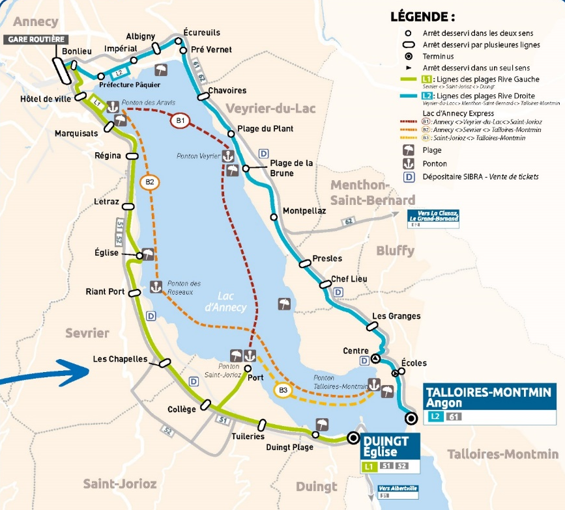
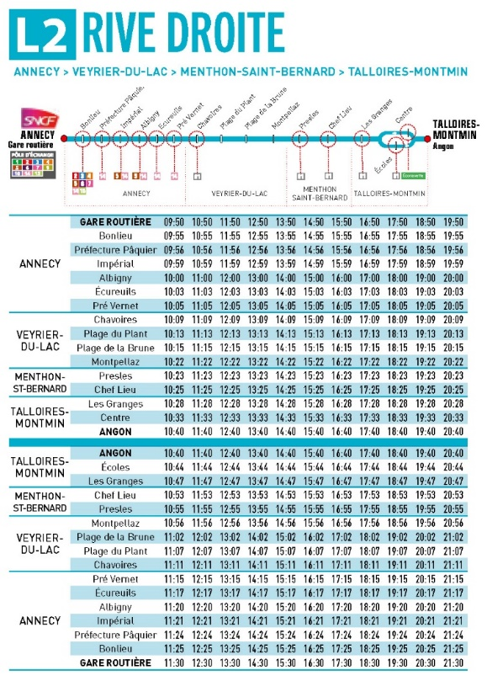
Day trip
10:30 Talloires
Bus line L2

Slide 13
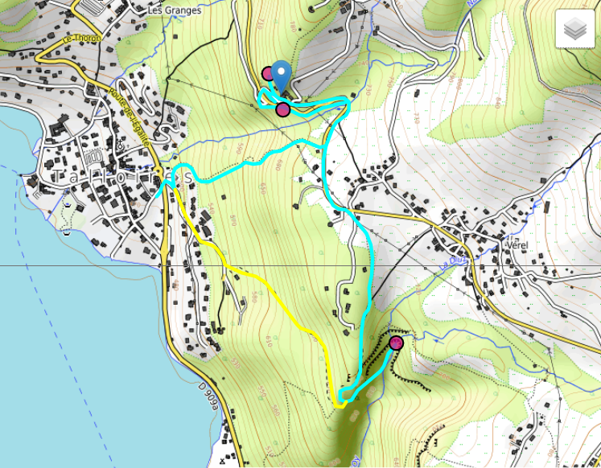
Day trip
Hike at
Hermitage Saint-Germain and Angon Waterfall
about 2h walk. Take sports shoes
Snack lunch at Talloires beach

Slide 14
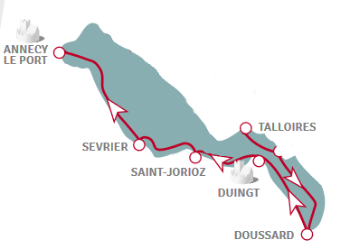
Day trip
14:50
Boat cruise to Annecy
or
Back with bus L2
Answer the survey !

